Slide 1
DEEP LEARNING
Artificial Neural Networks
An Object-Oriented Walkthrough — Neurons, Layers & Networks as Classes

Slide 2
AGENDA
Roadmap for Today
01
Why Neural Networks?
02
From Biology to Code
03
The Perceptron Era
04
Anatomy of a Network
05
Core Equations
06
Activation Functions
07
Forward Propagation
08
Applied Results
2

Slide 3
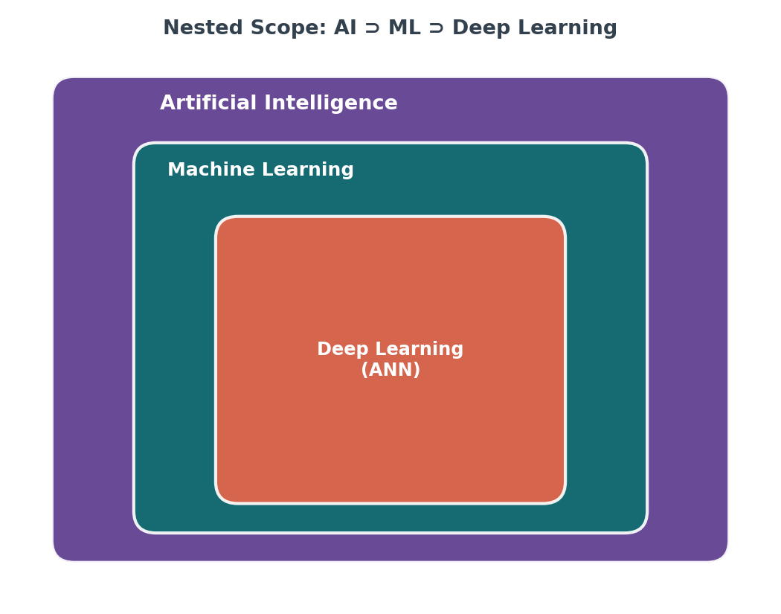
1 · INTRODUCTION
Why Neural Networks?
Traditional software needs hand-written rules for every case
Deep Learning learns the rule itself from labeled examples
No manual feature design — the network discovers useful patterns
One architecture family adapts to images, text, audio & tables
3

Slide 4
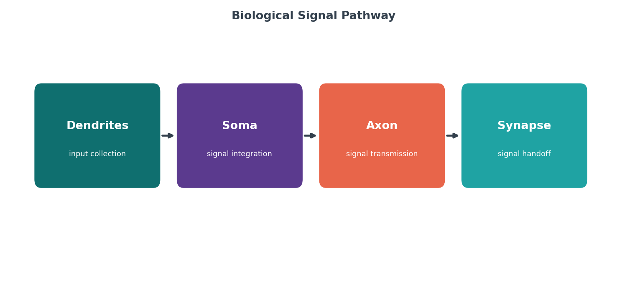
2 · BIOLOGY → CODE
From Biology to Code
Biology | ANN Equivalent
Dendrites gather input | Inputs × weights
Soma sums the charge | Weighted sum z = Σwx + b
Fires past a threshold | Activation function f(z)
Axon carries the signal on | Output passed to next layer
4

Slide 5
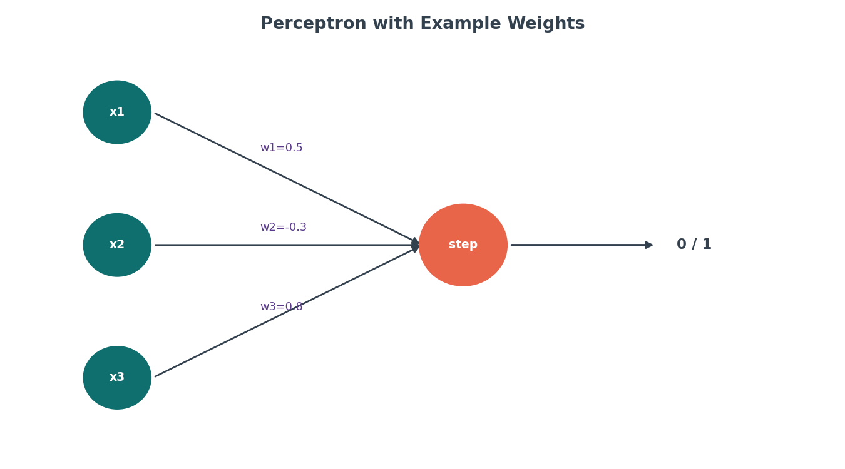
3 · THE PERCEPTRON ERA
Rosenblatt's Perceptron (1958)
First algorithm that learns weights from labeled examples
Decision rule: z = Σ(wᵢxᵢ) + b, then y = 1 if z ≥ 0 else 0
Update rule: wᵢ ← wᵢ + η·(y_true − y_pred)·xᵢ
1969: Minsky & Papert prove it can't learn XOR — a decade-long setback
5

Slide 6
3 · THE PERCEPTRON ERA
Strength vs Weakness
Strength | Weakness
Extremely fast to compute | Only draws one straight decision line
Easy to interpret weight-by-weight | Hard 0/1 output — no confidence score
Historically the starting point of ANN | Cannot represent XOR-type patterns
6

Slide 7
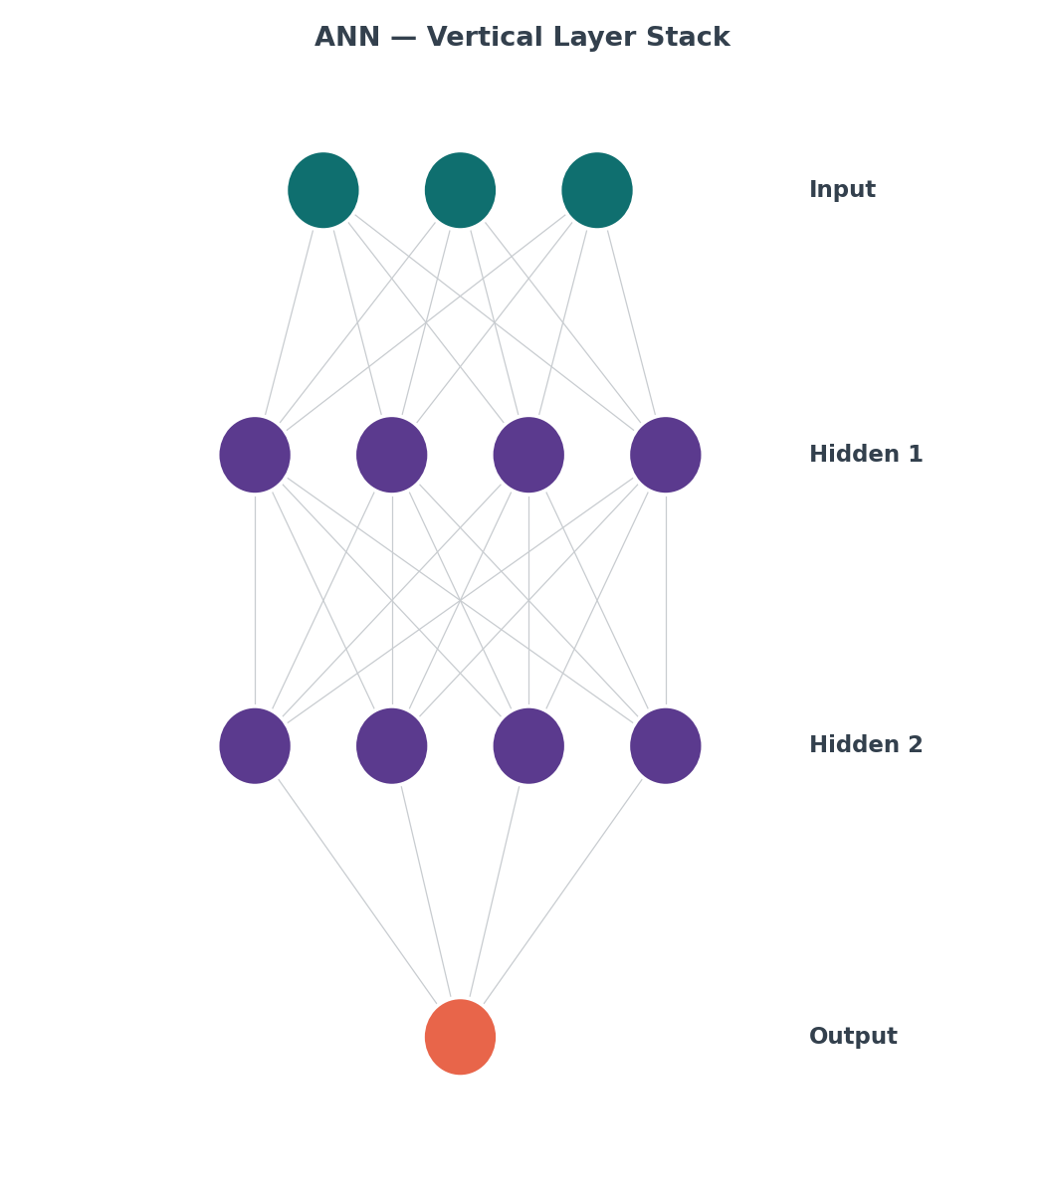
4 · ANATOMY OF A NETWORK
Layers of a Dense ANN
Input layer — one slot per feature, no computation performed
Hidden layer(s) — combine the entire previous layer's output; this is where representation learning happens
Output layer — shaped for the task (1 neuron for binary, N + softmax for multi-class)
In code: DenseNetwork([2,3,1]) builds exactly this 2→3→1 shape
7

Slide 8
5 · CORE EQUATIONS
From Inputs to Prediction
Step 1 — Linear Combination
Z = W·A_prev + b
Step 2 — Activation
A = f(Z)
Every layer applies these two steps in sequence — this is the entire content of DenseLayer.forward()
8

Slide 9
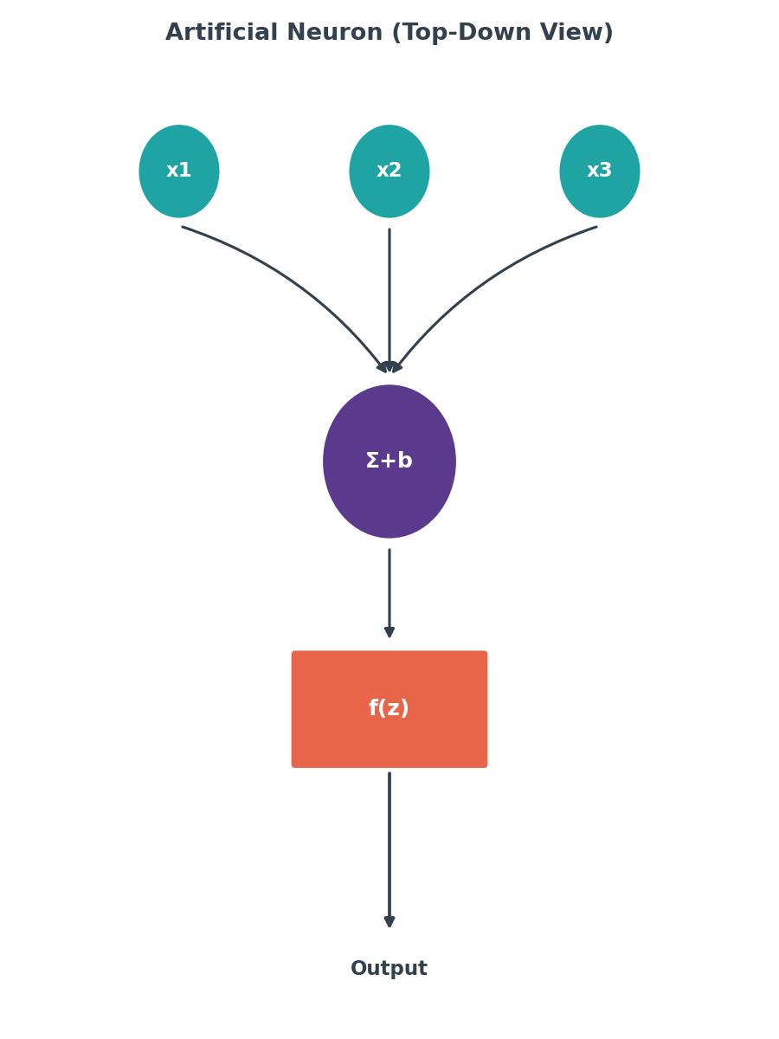
5 · CORE EQUATIONS
A Single Neuron, Top-Down
9

Slide 10
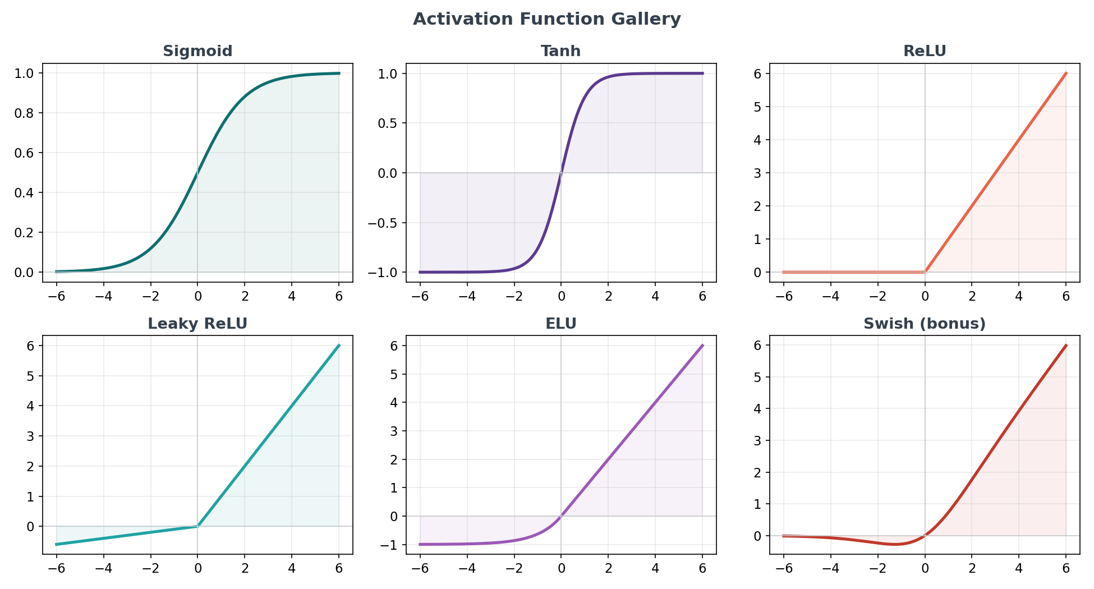
6 · ACTIVATION FUNCTIONS
The Activation Gallery
10

Slide 11
6 · ACTIVATION FUNCTIONS
When to Use Which
Function | Range | Best For
Sigmoid | (0, 1) | Binary output layer (probability)
Tanh | (−1, 1) | Zero-centered hidden layers
ReLU | [0, ∞) | Default hidden-layer choice
Leaky ReLU | (−∞, ∞) | Fixes 'dying' ReLU neurons
ELU | (−α, ∞) | Smoother negative-side gradients
Swish | (≈−0.28, ∞) | Modern ReLU alternative
Softmax | (0,1), Σ=1 | Multi-class output layer only
11

Slide 12
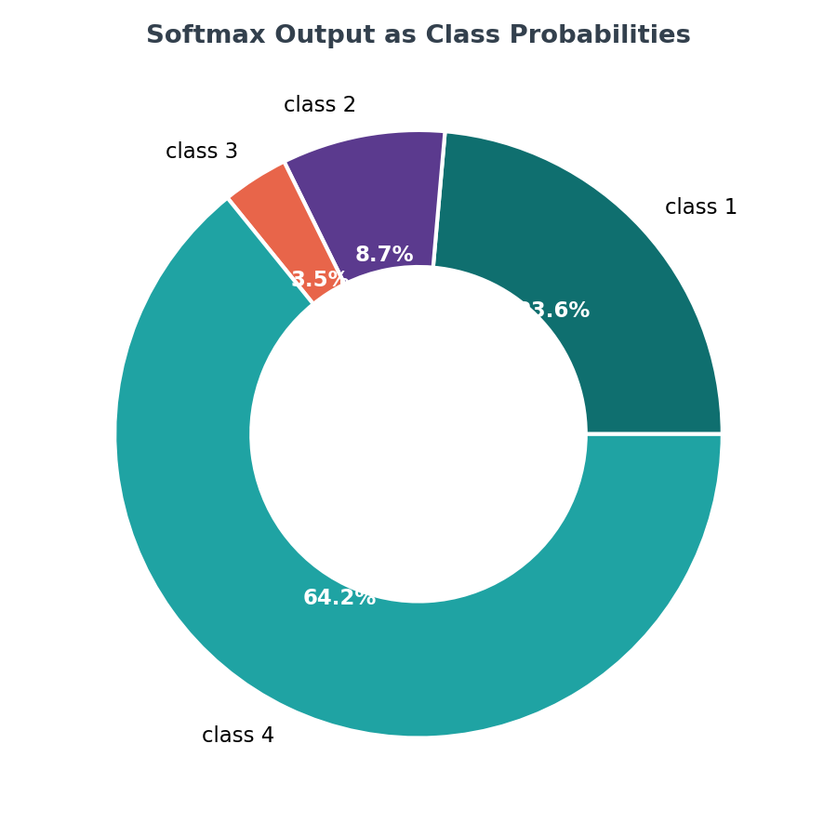
6 · ACTIVATION FUNCTIONS
Softmax Turns Logits into Probabilities
12

Slide 13
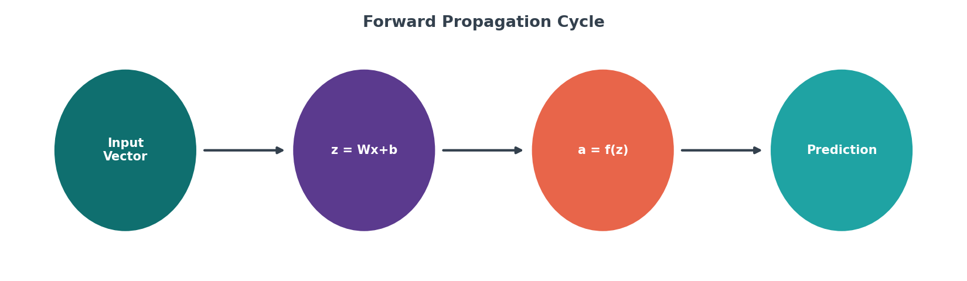
7 · FORWARD PROPAGATION
How Data Moves Forward
X = [0.6, 0.9] → Z1=W1·X+b1, A1=tanh(Z1) → Z2=W2·A1+b2, A2=sigmoid(Z2)
Verified identical to Keras once weights are copied — see ANN_Notebook_v2.ipynb, Sections 4–5
13

Slide 14
8 · TRAINING
Tuning Knobs (Hyperparameters)
Learning Rate
Batch Size
Epochs
Depth & Width
Dropout Rate
Size of each weight update step
Examples averaged per update
Full passes through training data
Hidden layers & neurons per layer
Fraction of neurons randomly disabled to fight overfitting
14

Slide 15
9 · TRADE-OFFS
Where ANN Shines / Where It Struggles
Shines
Struggles
Learns directly from raw data — no manual feature engineering
Can approximate any continuous function given enough capacity
Scales predictably with more data and compute
Needs large amounts of labeled data
Computationally expensive relative to simpler models
Hard to explain — a 'black box' by default
Can overfit without regularization like dropout
15

Slide 16
10 · DEPLOYMENTS
Real-World Deployments
Medical Diagnostics
Computer Vision
Financial Services
Tumor classification (this project's applied task)
Object & face recognition
Credit scoring, fraud detection
Language & Speech
Recommendation Engines
Forecasting
Transcription, translation, chatbots
Personalized content ranking
Demand planning, stock trends
16

Slide 17
11 · APPLIED PROJECT
Breast Cancer Wisconsin Classifier
569 samples, 30 numeric features, binary target (malignant / benign)
Architecture: 30 → 20 → Dropout(0.15) → 10 → 1 (sigmoid)
Optimizer: Adam, learning rate 0.001, 60 epochs, batch size 32
Dropout added specifically to reduce overfitting risk on this small dataset
17

Slide 18
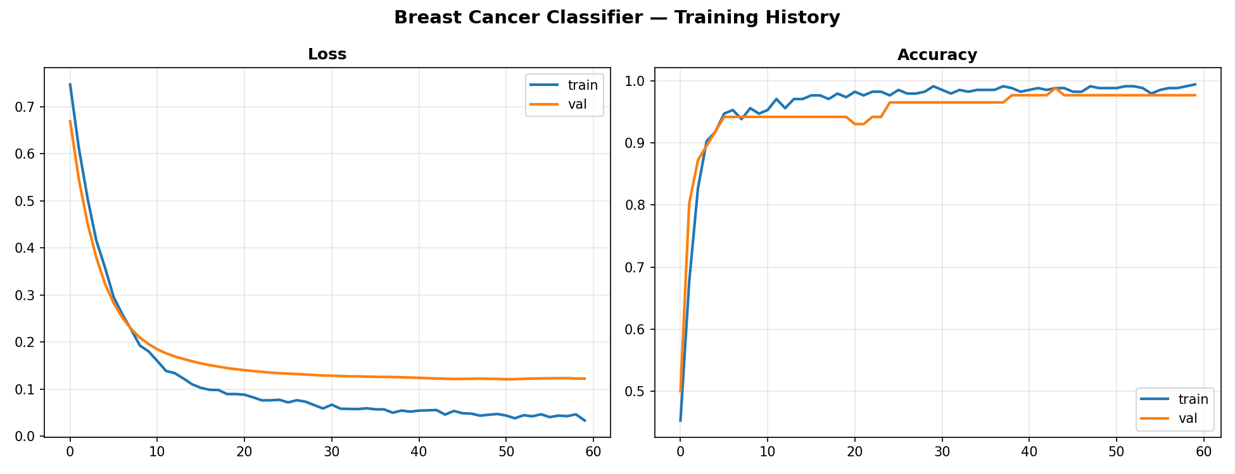
11 · APPLIED PROJECT
Training & Validation Curves
18

Slide 19
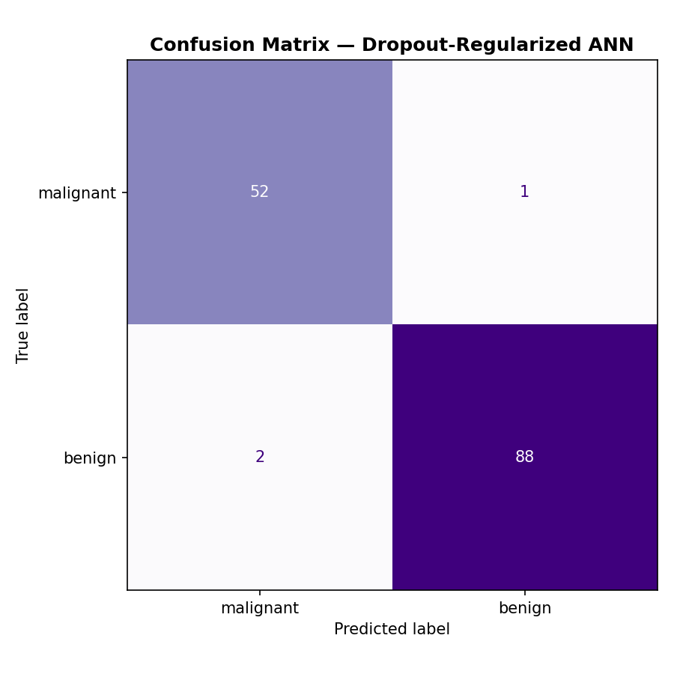
11 · APPLIED PROJECT
Confusion Matrix
19

Slide 20
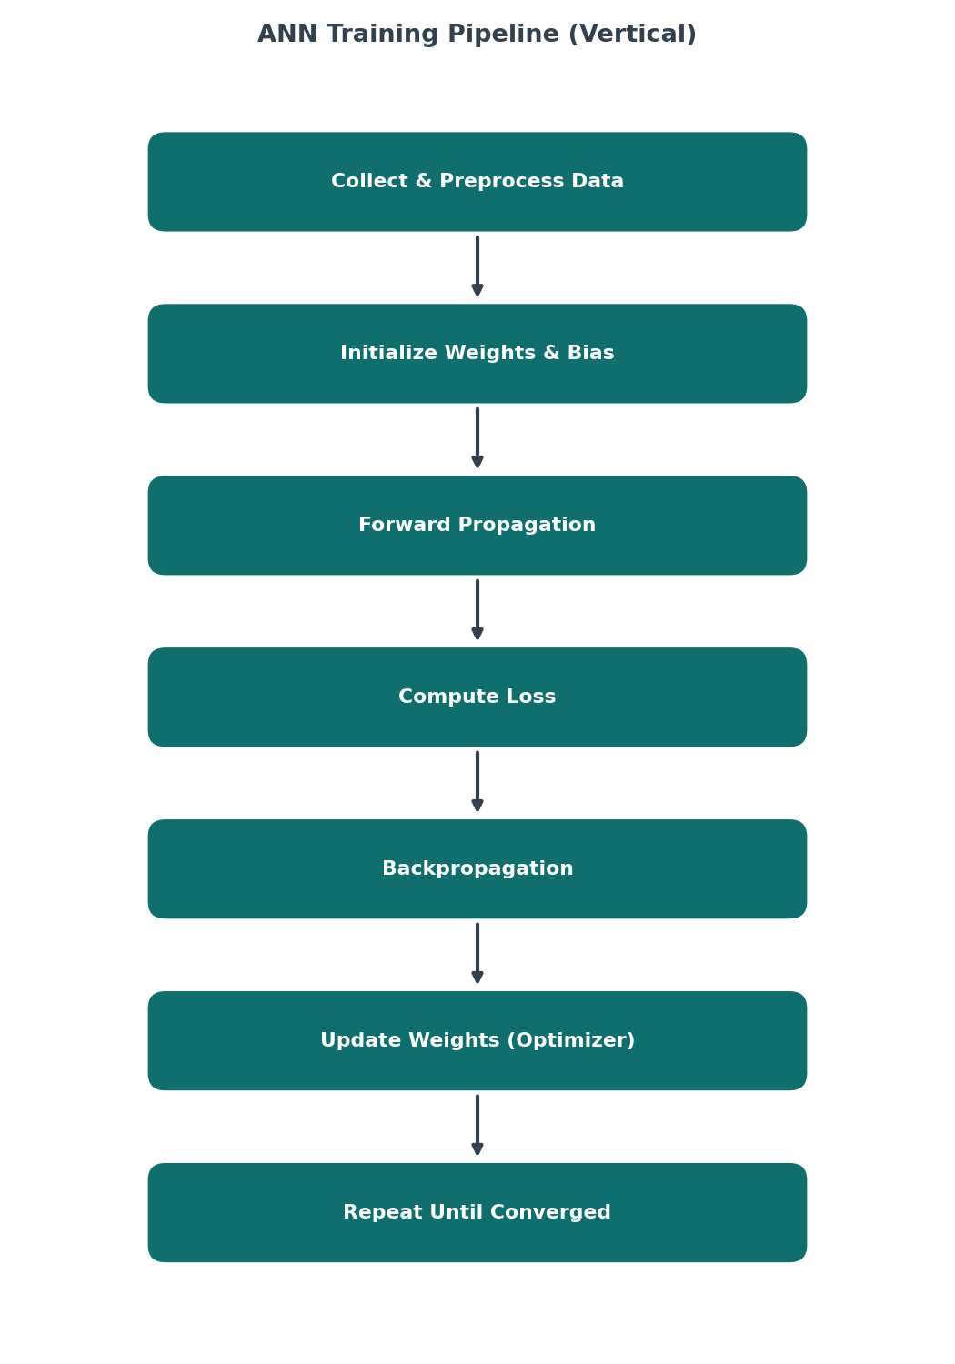
11 · APPLIED PROJECT
The Training Pipeline
20

Slide 21
Thank You
22

